Slide 1
European Day of Languages
Creators:Milica Jevtic,Magdalena Lukic,Tijana Kostic

Slide 2
English
Because of its widespread use in the world today, English is a universal world language, and its use greatly transcends the boundaries of the country in which it is spoken.

Slide 3
The importance of English
English is the third most spoken language in the world, with 360 to 400 milion speakers whose mother language is English.English is official language in 67 independent states.Also,English is the main language of business.It is also the most widely used language on the Internet and social networks,and a mandatory second language for learning in almost all countries of the world.

Slide 4
The importance of English on stage
Today, English is the most respected language in the world on the acting and music scene .There are many famous musicians who perform and sing their greatest hits in English, regardless of their mother tongue and the country they come from.

Slide 5
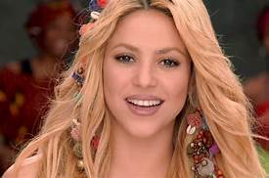
Shakira
Shakira is a world-famous music star whose official language is Spanish but she sings all her hits in English so that her audience from all over the world can understand her songs.

Slide 6
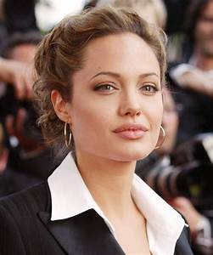
Angelina Jolie
Angelina Jolie is one of the most famous actresses from America. She won three Golden Globes and an Oscar for best supporting actress.
Many films have been in English because English is a universal language.

Slide 7
Conclusion
From all this we can best deduce the importance and role of the English language in the world. The language is essential for every person on the planet.

Slide 8
